Slide 1
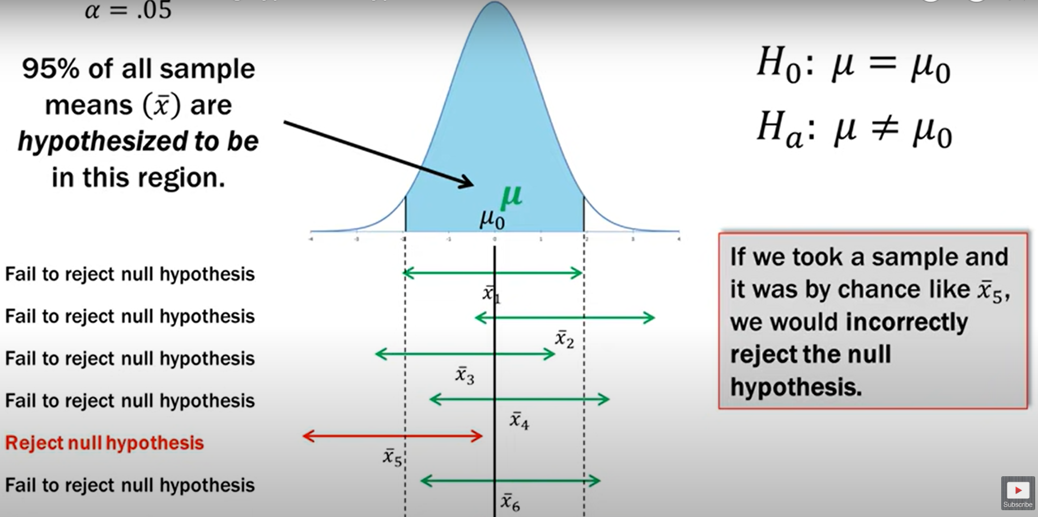
Visualizing Type I Errors
According to all the other samples, we will fail to reject H0, which is correct
Meaning: If by chance, the only sample we tested was x̄₅, we would commit Type I error
Type I error

Slide 2
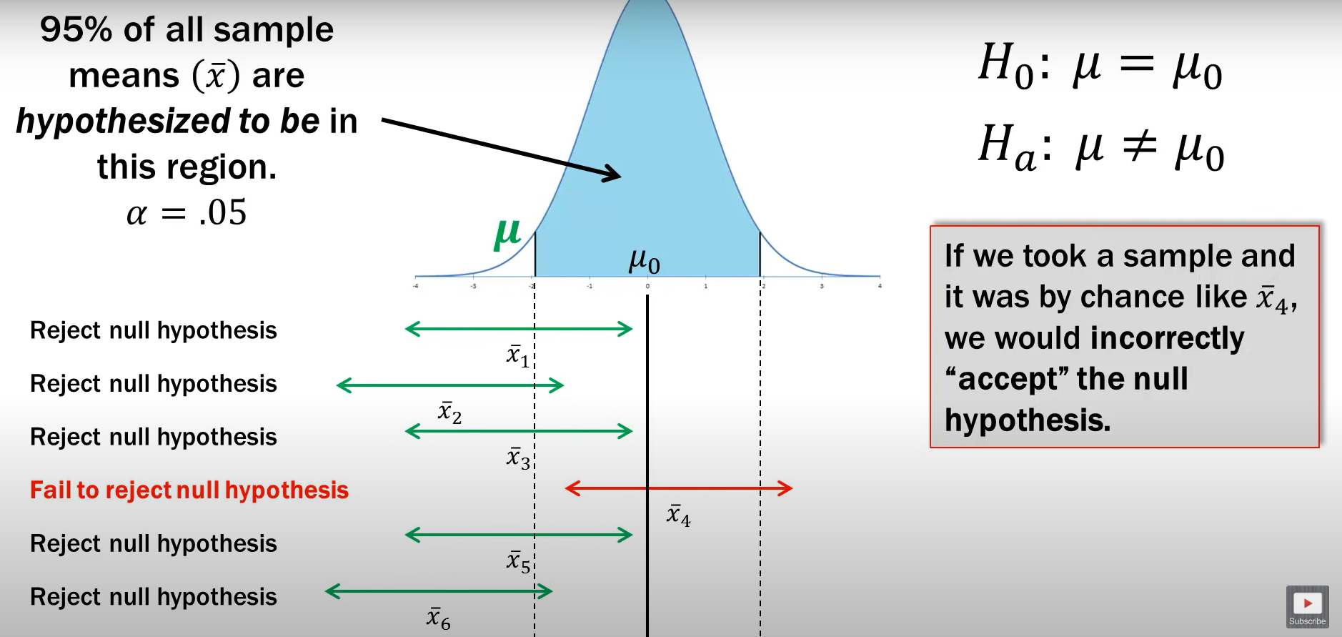
Similarly, Type II Error Now
According to all the other samples, we will reject H0, which is correct
Meaning: If by chance, the only sample we tested was x̄₄, we would commit Type II error

Slide 3
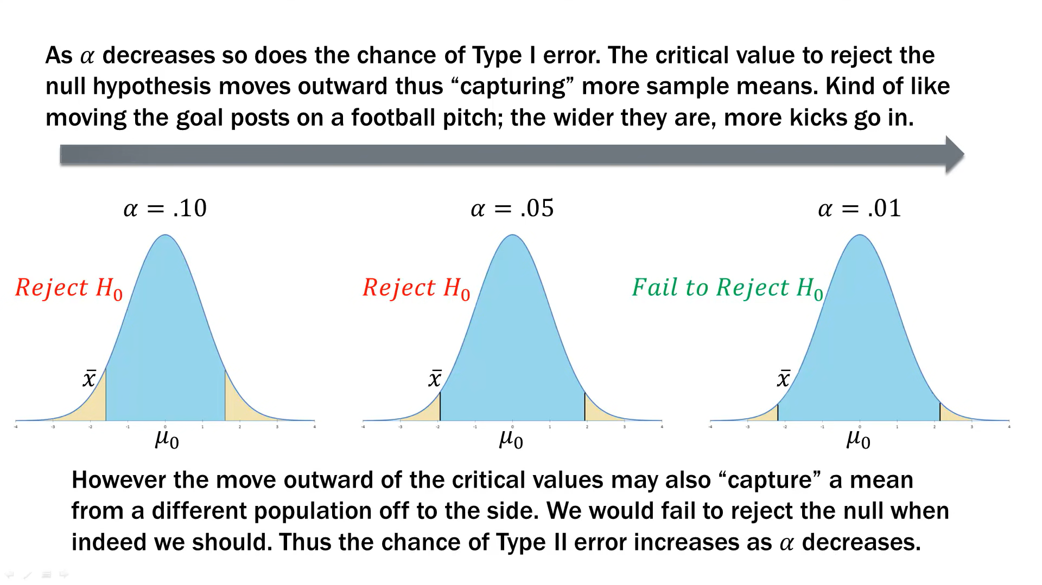

Slide 4
Time Series Forecasting

Slide 5
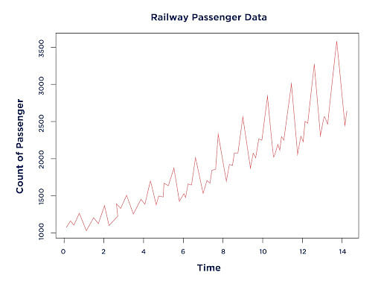
What is a Time Series?
Time series: Data arranged in the chronological order of time
Example: Profits of a company over the last few years, Price of Indian Rupee versus Euro over the last decade, Number of monthly railway passengers from 1960 to 1980

Slide 6
Time Series
A time series is a group of observations on a single entity over time — e.g. the daily price of oil
The key idea: Previous values are useful to predict the future values
How can the previous data be used to predict the future values?
Let us consider an example:
Earnings per share of Johnson and Johnson (Dataset: jj.xls)
Suppose we want to predict the EPS for the last year (1980)
We can use (1) Historical mean EPS (2) Mean of the second-last year (3) Only the last value of 1979 (4) Values of the second-last year
C:\code\Data Analytics\implementation\time_series_jj.py and jj.xls

Slide 7
Going Back in Time of Own Data: Lag
So, past can predict the future with trial and error
This is the key idea of lag
Day | Oil price in USD
1 | 100
2 | 98
3 | 102
4 | 101
5 | 100
Day | Oil price in USD | lag₁ | lag₂
1 | 100 | - | -
2 | 98 | 1 | -
3 | 102 | 2 | 1
4 | 101 | 3 | 2
5 | 100 | 4 | 3

Slide 8
Before Forecasting: Check Stationary
Stationary time series: Its properties do not depend on the time at which the series is observed (e.g. patterns, seasonality) – to be discussed in detail shortly …
C:\code\Data Analytics\implementation\time_series\time-series-basics\8_forecasting_intro.py

Slide 9
Auto Regressive (AR) Model
Day (d) | Oil price in USD (y) | lag₁ | lag₂
1 | 100 | - | -
2 | 98 | 1 | -
3 | 102 | 2 | 1
4 | 101 | 3 | 2
5 | 100 | 4 | 3
To predict y, we can say that y is dependent on the previous values
y ~ f(lag₁, lag₂, …)
Example: For day 6, (d = 6), lag₁ = 5, lag₂ = 4, lag₃ = 3, lag₄ = 2, lag₅ = 1
Because we are predicting y using its own previous values, this is called as Auto Regressive (AR) Model

Slide 10
Creating a Time Series
First run C:\code\Data Analytics\implementation\time_series\1_load_data.py
This loads the airlines data set, formats date, and makes it an index column
C:\code\Data Analytics\implementation\time_series\2_visualize.py
Shows a line plot of date versus passenger count
Shows patterns of up and down
There are four types of time series patterns (See next slide)
Trend: Dependent variable value increases or decreases over time (e.g. cumulative runs scored by a batsman in his career – will always show an increasing value)
Seasonal: Goes up in certain times (e.g. high sales during Christmas and year end)
Cyclic: Will go up for a time (not fixed), then go down for a time (not fixed) (e.g. boom and bust in financial markets)
Irregular: No pattern

Slide 11
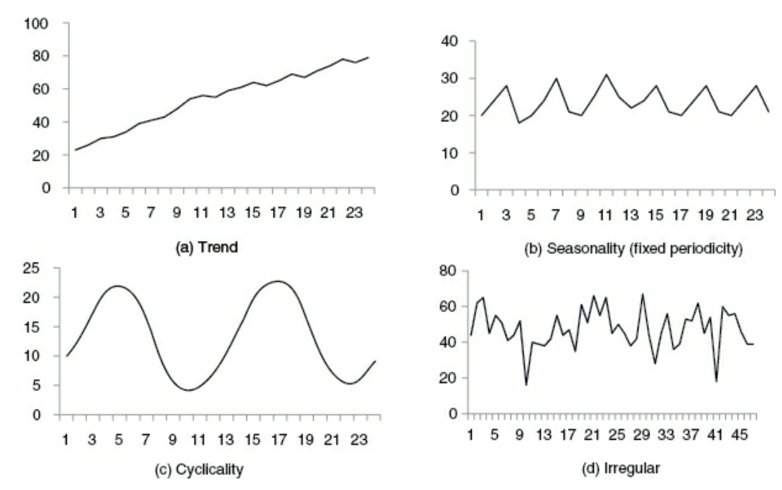
Time Series Components

Slide 12
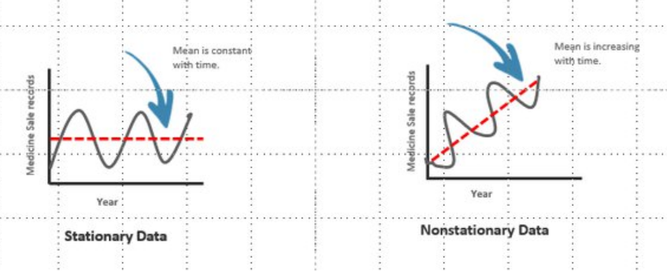
Creating a Time Series – Stationary Time Series
C:\code\Data Analytics\implementation\time_series\3_Check_stationary.py
Before doing time series analysis, we need to check if data is stationary
A stationary time series is one whose properties do not depend on the time at which the series is observed (e.g. patterns, seasonality)
In such a series, the mean and standard deviation do not vary over time

Slide 13
Creating a Time Series – Checking Stationarity
Augmented Dickey-Fuller Test (ADF)
We start with a denial, i.e. H0 = The data is not stationary
If Test statistic < Critical values, we reject the null hypothesis
Rolling Statistics
Simply take the rolling mean, rolling standard division and plot it (See next slide for ‘Rolling’ concept)

Slide 14
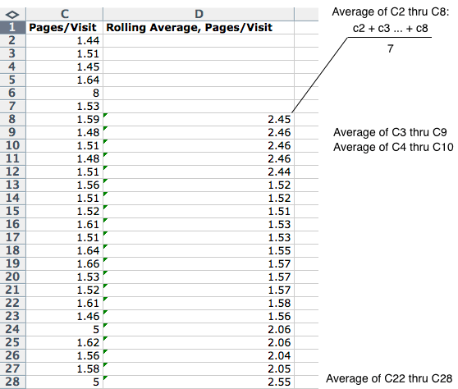
Rolling Mean Concept

Slide 15
Creating a Time Series – Make the Data Stationary
We can use any of the following methods, not in any sequence, and just stop after one of them works
Time shift: Simplest
Log
Square root, Cube root, …

Slide 16
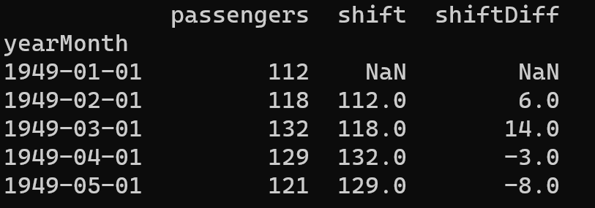
Creating a Time Series – Make Stationary – Time Shift
C:\code\Data Analytics\implementation\time_series\4_Make_Stationary.py

Slide 17
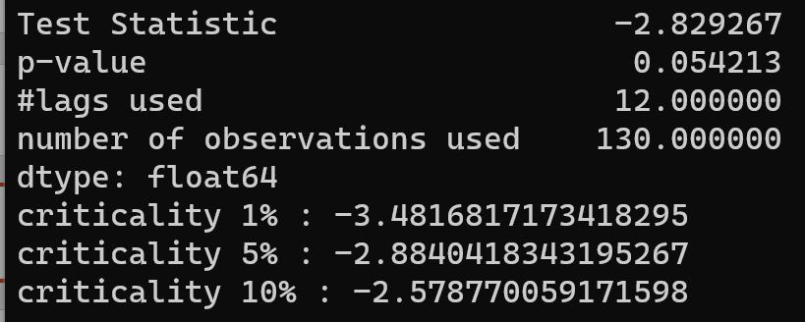
Creating a Time Series – Make Stationary – Time Shift - Results
The level of statistical significance is often expressed as a p-value between 0 and 1. The smaller the p-value, the stronger the evidence that you should reject the null hypothesis.
Better than earlier
The data has become somewhat stationary
We will not try other make stationary techniques such as log, square root, cube root, etc

Slide 18
Creating a Time Series – ARIMA
Autoregressive Integrated Moving Average (ARIMA)
A statistical analysis model that uses time series data to either better understand the data set or to predict future trends
A statistical model is autoregressive if it predicts future values based on past values
Example: an ARIMA model might predict passenger count based on the past passenger count, or a stock’s future price based on the past prices
Useful for short-term predictions

Slide 19
Creating a Time Series – ARIMA in Python
ARIMA (p, d, q)
Auto regressive p
Integrated d
Moving average q
p: How much in the past should we go? (Use PACF)
d: Number of differences to make the time series stationary
q: Number of unknown terms that multiply our forecast errors in the past (Use ACF)
Shift = d = 1

Slide 20
ACF
Auto Correlation Function (ACF) is a regression model that tells us about the correlation of y with its own lags, i.e.
Between y and lag₁y
Between y and lag₂y
Between y and lag₃y
…
Generally, we plot a graph showing lag on the x-axis and the correlation of today’s value with the lag value on the y-axis
Example: Next slide

Slide 21
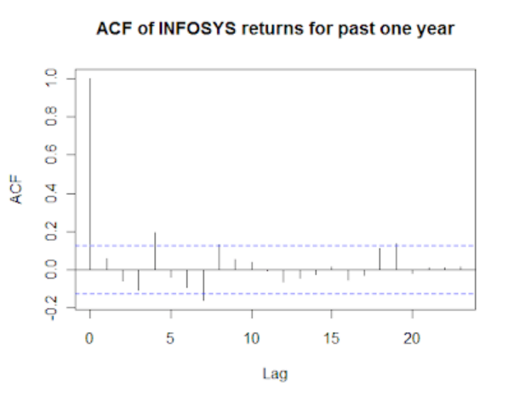
ACF
Today’s value compared with today’s value, so correlation is 100% or 1
Blue lines: 95% confidence interval lines
Values crossing the lines are significant, i.e. today’s return and that day’s return have a statistically significant relationship
Corelation of today’s price with yesterday’s price (Lag = 1)
Corelation of today’s price with price 2 days ago (Lag = 2)

Slide 22
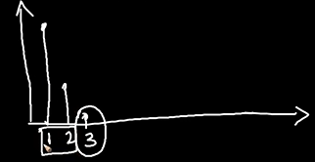
PACF
Partially Auto Correlation Function (PACF) is similar to ACF
Conveys the relationship of y with its lags, but after removing the effects of the intermediate lags
Example: Here, if we want to see relationship between y and lag₃y then it does so after removing the effects of lag₁y and lag₂y
Conveys the strength of lag₃y only

Slide 23
Creating a Time Series – SARIMAX
Seasonal Autoregressive Integrated Moving Average Exogenous model (SARIMAX)
Seasonality occurs when certain patterns are not consistent, but appear periodically
So, a simple autoregressive component would not describe that data well
Example: Low sale in November will result into a similar prediction for December (incorrect), but actual high sale in December will result into a similar prediction for January (also incorrect)
Here, SARIMAX comes into picture

Slide 24
ARIMA (p, d, q)
SARIMAX (p, d, q) (P, D, Q, s)
P, D, Q are seasonal equivalents of p, d, q
s is the length of the cycle
Example:
ARIMA (1, 1, 2)
p: Current month’s sales depends on the previous month’s sales (1)
d: We need to take one lag to make data stationary (1)
q: Consider the influence of one past forecast error (2)
SARIMAX (1, 1, 1) (1,1,1,12)
First three: Similar to ARIMA; then we have four more
P: Capturing the influence of the same month last year (1)
D: We need to take one seasonal lag to make data stationary (1)
Q: Consider the influence of one past seasonal forecast error (1)
s: Assume monthly data, considering yearly seasonality (12)
Also see c:\code\Data Analytics\implementation\arima_sarimax.py

